Slide 1
Announcements
We are now in Phase 3 of the course Algorithms and Software Engineering.
Lectures in this phase:
Algorithms.
3 software engineering lectures (we already did #1).
Optional textbook for software engineering lectures: “A Philosophy of Software Design” by John Ousterhout.

Slide 2
Announcements
Phase 3 of the course starts today: Algorithms and Software Engineering.
Assignments in this phase:
Proj2C: A* Algorithm. This is relatively short if you’ve already understood A* from before the midterm.
Project 2D: Bear Maps. You combine your work from Proj2A, Proj2B, and Proj2C into a mapping application.
Project 3: Build Your Own World.
Your chance to do some design and software engineering.
You’ll decide your own task and approach.
Partner project, so try to find a partner soon.

Slide 3
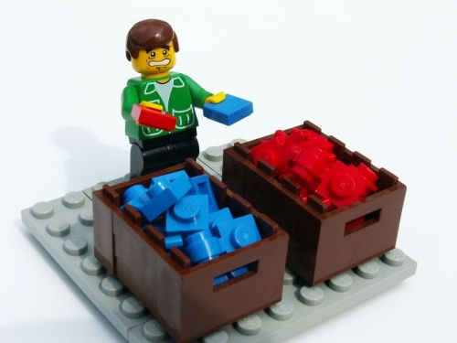
CS61B
Lecture 29: Sorting I
The Sorting Problem
Selection Sort, Heapsort
Mergesort
Insertion Sort
Shell’s Sort (Extra)

Slide 4
Our Major Focus for Several Lectures: Sorting
For many of our remaining lectures, we’ll discuss the sorting problem.
Informally: Given items, put them in order.
This is a useful task in its own right. Examples:
Equivalent items are adjacent, allowing rapid duplicate finding.
Items are in increasing order, allowing binary search.
Can be converted into various balanced data structures (e.g. BSTs, KdTrees).
Also provide interesting case studies for how to approach basic computational problems.
Some of the solutions will involve using data structures we’ve studied.

Slide 5
Sorting - Definitions (from Knuth’s TAOCP)
An ordering relation < for keys a, b, and c has the following properties:
Law of Trichotomy: Exactly one of a < b, a = b, b < a is true.
Law of Transitivity: If a < b, and b < c, then a < c.
An ordering relation with the properties above is also known as a “total order”.
A sort is a permutation (re-arrangement) of a sequence of elements that puts the keys into non-decreasing order relative to a given ordering relation.
x₁ ≤ x₂ ≤ x₃≤ ...≤ x_{N}

Slide 6
Example: String Length
Example of an ordering relation: The length of strings.
Law of Trichotomy: Exactly one of the following is true:
len(a) < len(b)
len(a) = len(b)
len(b) < len(a)
Law of Transitivity: If len(a) < len(b) and len(b) < len(c), then len(a) < len(c).
Two valid sorts for [“cows”, “get”, “going”, “the”] for the ordering relation above:
[“the”, “get”, “cows”, “going”]
[“get”, “the”, “cows”, “going”]
Under this relation, “the” is considered = to “get”, since len(“the”) = len(“get”).
= under the relation, not the Java idea of .equals

Slide 7
Java Note
Ordering relations are typically given in the form of compareTo or compare methods.
Note that with respect to the order defined by the method above “the” = “get”.
This usage of = is not the same as the equals given by the String method.
import java.util.Comparator;
public class LengthComparator implements Comparator<String> {
public int compare(String x, String b) {
return x.length() - b.length();
}
}

Slide 8


Sorting: An Alternate Viewpoint
An inversion is a pair of elements that are out of order with respect to <.
0 1 1 2 3 4 8 6 9 5 7
8-6 8-5 8-7 6-5 9-5 9-7
(6 inversions out of 55 max)
Yoda
Gabriel Cramer
Another way to state the goal of sorting:
Given a sequence of elements with Z inversions.
Perform a sequence of operations that reduces inversions to 0.

Slide 9
Performance Definitions
Characterizations of the runtime efficiency are sometimes called the time complexity of an algorithm. Example:
Dijkstra’s has time complexity O(E log V).
Characterizations of the “extra” memory usage of an algorithm is sometimes called the space complexity of an algorithm.
Dijkstra’s has space complexity Θ(V) (for queue, distTo, edgeTo).
Note that the graph takes up space Θ(V+E), but we don’t count this as part of the space complexity of Dijkstra since the graph itself already exists and is an input to Dijkstra’s.

Slide 10
Selection Sort and Heapsort
Notes:
5 min to get here

Slide 11
Selection Sort
We’ve seen this already.
Find smallest item.
Swap this item to the front and ‘fix’ it.
Repeat for unfixed items until all items are fixed.
Demo: https://goo.gl/g14Cit
Sort Properties:
Θ(N²) time if we use an array (or similar data structure).
Seems inefficient: We look through entire remaining array every time to find the minimum.

Slide 12
Naive Heapsort: Leveraging a Max-Oriented Heap
Idea: Instead of rescanning entire array looking for minimum, maintain a heap so that getting the minimum is fast!
For reasons that will become clear soon, we’ll use a max-oriented heap.
Naive heapsorting N items:
Insert all items into a max heap, and discard input array. Create output array.
Repeat N times:
Delete largest item from the max heap.
Put largest item at the end of the unused part of the output array.
Naive Heapsort Demo: https://goo.gl/EZWwSJ
A min heap would work as well, but wouldn’t be able to take advantage of the fancy trick in a few slides.

Slide 13
Naive Heapsort Runtime: http://yellkey.com/couple
Naive heapsorting N items:
Insert all items into a max heap, and discard input array. Create output array.
Repeat N times:
Delete largest item from the max heap.
Put largest item at the end of the unused part of the output array.
What is the TOTAL runtime of naive heapsort?
Θ(N)
Θ(N log N)
Θ(N²), but faster than selection sort.

Slide 14
Heapsort Runtime Analysis
Use the magic of the heap to sort our data.
Getting items into the heap O(N log N) time.
Selecting largest item: Θ(1) time.
Removing largest item: O(log N) for each removal.
Overall runtime is O(N log N) + Θ(N) + O(N log N) = O(N log N)
Far better that selection sort!
Memory usage is Θ(N) to build the additional copy of all of our data.
Worse than selection sort, but probably no big deal (??).
Can eliminate this extra memory cost with same fancy trickery.

Slide 15
In-place Heapsort
Alternate approach, treat input array as a heap!
Rather than inserting into a new array of length N + 1, use a process known as “bottom-up heapification” to convert the array into a heap.
To bottom-up heapify, just sink nodes in reverse level order.
Avoids need for extra copy of all data.
Once heapified, algorithm is almost the same as naive heap sort.
In-place heap sort: Demo
32
15
2
17
19
26
41
17
17
heapification
41
19
32
17
15
26
2
17
17
For this algorithm we don’t leave spot 0 blank.

Slide 16
In-place Heapsort Runtime: http://yellkey.com/response
Use the magic of the heap to sort our data.
Bottom-up Heapification: O(???) time.
Selecting largest item: Θ(1) time.
Removing largest item: O(log N) for each removal.
Give the time complexity of in-place heapsort in big O notation.
O(N)
O(N log N)
O(N²)

Slide 17
In-place Heapsort Runtime
Use the magic of the heap to sort our data.
Bottom-up Heapification: O(N log N) time.
Selecting largest item: Θ(1) time.
Removing largest item: O(log N) for each removal.
Give the time complexity of in-place heapsort in big O notation.
O(N log N)
Bottom-up heapification is N sink operations, each taking no more than O(log N) time, so overall runtime for heapification is O(N log N).
Extra for experts, show that bottom-up heapification is Θ(N) in the worst case.
More extra for experts, show heapsort is Θ(N log N) in the worst case.

Slide 18
In-place Heapsort: http://yellkey.com/tell
What is the memory complexity of Heapsort?
Also called “space complexity”.
Θ(1)
Θ(log N)
Θ(N)
Θ(N log N)
Θ(N²)

Slide 19
In-place Heapsort: http://yellkey.com/tell
What is the memory complexity of Heapsort?
Also called “space complexity”.
Θ(1)
Θ(log N)
Θ(N)
Θ(N log N)
Θ(N²)
Incorrect answer given by student during lecture: Θ(N): Creating N spots for a min heap.
Actually I’m not, I’m reusing the same array that I was given. In other words, the algorithm is in-place.

Slide 20
In-place Heapsort
What is the memory complexity of Heapsort?
Also called “space complexity”.
Θ(1)
Θ(log N)
Θ(N)
Θ(N log N)
Θ(N²)
The only extra memory we need is a constant number instance variables, e.g. size.
Unimportant caveat: If we employ recursion to implement various heap operations, space complexity is Θ(log N) due to need to track recursive calls. The difference between Θ(log N) and Θ(1) space is effectively nothing.

Slide 21
Sorts So Far
 | Best Case Runtime | Worst Case Runtime | Space | Demo | Notes
Selection Sort | Θ(N²) | Θ(N²) | Θ(1) | Link
Heapsort (in place) | Θ(N)* | Θ(N log N) | Θ(1) | Link | Bad cache (61C) performance.
*: An array of all duplicates yields linear runtime for heapsort.

Slide 22
Mergesort

Slide 23
Mergesort
We’ve seen this one before as well.
Mergesort: Demo
Split items into 2 roughly even pieces.
Mergesort each half (steps not shown, this is a recursive algorithm!)
Merge the two sorted halves to form the final result.
Time complexity, analysis from previous lecture: Θ(N log N runtime)
Space complexity with aux array: Costs Θ(N) memory.
Also possible to do in-place merge sort, but algorithm is very complicated, and runtime performance suffers by a significant constant factor.

Slide 24
Sorts So Far
 | Best Case Runtime | Worst Case Runtime | Space | Demo | Notes
Selection Sort | Θ(N²) | Θ(N²) | Θ(1) | Link
Heapsort (in place) | Θ(N)* | Θ(N log N) | Θ(1) | Link | Bad cache (61C) performance.
Mergesort | Θ(N log N) | Θ(N log N) | Θ(N) | Link | Faster than heap sort.
*: An array of all duplicates yields linear runtime for heapsort.

Slide 25
Insertion Sort

Slide 26
Insertion Sort
General strategy:
Starting with an empty output sequence.
Add each item from input, inserting into output at right point.
Naive approach, build entirely new output: Demo (Link)
Input:
32
15
2
17
19
26
41
17
17
Output:

Slide 27
Insertion Sort
General strategy:
Starting with an empty output sequence.
Add each item from input, inserting into output at right point.
Naive approach, build entirely new output: Demo (Link)
Input:
32
15
2
17
19
26
41
17
17
Output:
2
15
17
17
17
19
26
32
41

Slide 28
Insertion Sort
General strategy:
Starting with an empty output sequence.
Add each item from input, inserting into output at right point.
For naive approach, if output sequence contains k items, worst cost to insert a single item is k.
Might need to move everything over.
More efficient method:
Do everything in place using swapping: Demo (Link)

Slide 29
In-place Insertion Sort
Two more examples.
7 swaps:
36 swaps:
P O T A T O
P O T A T O (0 swaps)
O P T A T O (1 swap )
O P T A T O (0 swaps)
A O P T T O (3 swaps)
A O P T T O (0 swaps)
A O O P T T (3 swaps)
S O R T E X A M P L E
S O R T E X A M P L E (0 swaps)
O S R T E X A M P L E (1 swap )
O R S T E X A M P L E (1 swap )
O R S T E X A M P L E (0 swaps)
E O R S T X A M P L E (4 swaps)
E O R S T X A M P L E (0 swaps)
A E O R S T X M P L E (6 swaps)
A E M O R S T X P L E (5 swaps)
A E M O P R S T X L E (4 swaps)
A E L M O P R S T X E (7 swaps)
A E E L M O P R S T X (8 swaps)
Purple: Element that we’re moving left (with swaps).
Black: Elements that got swapped with purple.
Grey: Not considered this iteration.

Slide 30
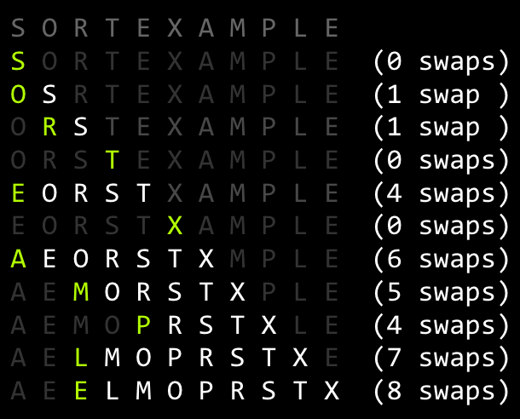
Insertion Sort Runtime: http://yellkey.com/arrive
What is the runtime of insertion sort?
Ω(1), O(N)
Ω(N), O(N)
Ω(1), O(N²)
Ω(N), O(N²)
Ω(N²), O(N²)
36 swaps:

Slide 31
Insertion Sort Runtime
What is the runtime of insertion sort?
Ω(1), O(N)
Ω(N), O(N)
Ω(1), O(N²)
Ω(N), O(N²)
Ω(N²), O(N²)
You may recall Ω is not “best case”.
So technnnniically you could also say Ω(1)
36 swaps:

Slide 32
Picking the Best Sort: http://yellkey.com/machine
Suppose we do the following:
Read 1,000,000 integers from a file into an array of length 1,000,000.
Mergesort these integers.
Select one integer randomly and change it.
Sort using algorithm X of your choice.
Which sorting algorithm would be the fastest choice for X?
Selection Sort
Heapsort
Mergesort
Insertion Sort

Slide 33


Observation: Insertion Sort on Almost Sorted Arrays
For arrays that are almost sorted, insertion sort does very little work.
Left array: 5 inversions, so only 5 swaps.
Right array: 3 inversion, so only 3 swaps.

Slide 34
Picking the Best Sort (Poll Everywhere)
Suppose we do the following:
Read 1,000,000 integers from a file into an array of length 1,000,000.
Mergesort these integers.
Select one integer randomly and change it.
Sort using algorithm X of your choice.
In the worst case, we have 999,999 inversions: Θ(N) inversions.
Which sorting algorithm would be the fastest choice for X? Worst case run-times:
Selection Sort: Θ(N²)
Heapsort: Θ(N log N)
Mergesort: Θ(N log N)
Insertion Sort: Θ(N)

Slide 35
Insertion Sort Sweet Spots
On arrays with a small number of inversions, insertion sort is extremely fast.
One exchange per inversion (and number of comparisons is similar). Runtime is Θ(N + K) where K is number of inversions.
Define an almost sorted array as one in which number of inversions ≤ cN for some c. Insertion sort is excellent on these arrays.
Less obvious: For small arrays (N < 15 or so), insertion sort is fastest.
More of an empirical fact than a theoretical one.
Theoretical analysis beyond scope of the course.
Rough idea: Divide and conquer algorithms like heapsort / mergesort spend too much time dividing, but insertion sort goes straight to the conquest.
The Java implementation of Mergesort does this (Link).

Slide 36
Sorts So Far
 | Best Case Runtime | Worst Case Runtime | Space | Demo | Notes
Selection Sort | Θ(N²) | Θ(N²) | Θ(1) | Link
Heapsort (in place) | Θ(N)* | Θ(N log N) | Θ(1) | Link | Bad cache (61C) performance.
Mergesort | Θ(N log N) | Θ(N log N) | Θ(N) | Link | Fastest of these.
Insertion Sort (in place) | Θ(N) | Θ(N²) | Θ(1) | Link | Best for small N or almost sorted.

Slide 37
Shell’s Sort (Extra)
(Not on Exam)

Slide 38
Optimizing Insertion Sort: Shell’s Sort
Big idea: Fix multiple inversions at once.
Instead of comparing adjacent（相邻） items, compare items that are one stride length h apart.
Start with large stride, and decrease towards 1.
Example: h = 7, 3, 1.
Notes:
Named after Donald Shell, its inventor. Not named after some sort of sea shell game.

Slide 39
Optimizing Insertion Sort: Shell’s Sort
h=1 is just insertion sort.
7-sorting:
3 swaps
1-sorting:
6 swaps
S O R T E X A M P L E
M O R T E X A S P L E (1 swap, > 1 inversion)
M O R T E X A S P L E (0 swaps)
M O L T E X A S P R E (1 swap, > 1 inversion)
M O L E E X A S P R T (1 swap, > 1 inversion)
A E L E O P M S X R T
A E L E O P M S X R T
A E L E O P M S X R T
A E L E O P M S X R T
A E E L O P M S X R T
A E E L O P M S X R T
A E E L O P M S X R T
A E E L M O P S X R T
A E E L M O P S X R T
A E E L M O P S X R T
A E E L M O P R S X T
A E E L M O P R S T X
3-sorting:
5 swaps
M O L E E X A S P R T
E O L M E X A S P R T (1 swap, >1 inversions)
E E L M O X A S P R T (1 swap, >1 inversions)
E E L M O X A S P R T (0 swaps, 0 inversions)
A E L E O X M S P R T (2 swaps, >1 inversions)
A E L E O X M S P R T (0 swaps, 0 inversions)
A E L E O P M S X R T (1 swaps, >1 inversions)
A E L E O P M S X R T (0 swaps, 0 inversions)
A E L E O P M S X R T (0 swaps, 0 inversions)
Total swaps: 14 (vs. 31)
Example from Algorithms 4th Edition

Slide 40
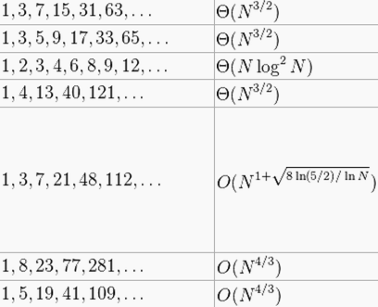
Shell’s Sort: Generalization and Performance
h=1 is just normal insertion sort.
By using large strides first, fixes most of the inversions.
We used 7, 3, 1. Can generalize to 2^{k} - 1 from some k down to 1.
Requires Θ(N^{1.5}) time in the worst case (see CS170).
Other stride patterns can be faster.

Slide 41
Sorts So Far
 | Best Case Runtime | Worst Case Runtime | Space | Demo | Notes
Selection Sort | Θ(N²) | Θ(N²) | Θ(1) | Link
Heapsort (in place) | Θ(N)* | Θ(N log N) | Θ(1) | Link | Bad cache (61C) performance.
Mergesort | Θ(N log N) | Θ(N log N) | Θ(N) | Link | Fastest of these.
Insertion Sort (in-place) | Θ(N) | Θ(N²) | Θ(1) | Link | Best for small N or almost sorted.
Shell’s Sort | Θ(N) | Ω(N log N), O(?) | Θ(1) | N/A | Rich theory!
An earlier version of this slide assumed that Heapsort was always given an array with no duplicate elements. If we omit(省略) this assumption, heapsort’s best case is Θ(N).

Slide 42
Citations
Lego man: http://thetechnicgear.com/wp-content/uploads/2014/02/sorting-lego.jpg
Keynote Animations of Algorithms courtesy of Kevin Wayne

